Slide 1
Concepts

Slide 2
Who Am I?
Professor: Rajib Paul (PhD)
  Email: rajib@ajou.ac.kr
  School: Masters + PhD, Ajou University
  Office: Paldall Hall #1011
  Visiting hours: Not decided yet

Slide 3




My Thoughts
It’s more important that everyone understand
a topic than I finish a lecture on time.
Blah blah blah blah blah
Don’t be shy!!!
If something confuses you…
?
?
?
?
?
it probably confuses 5 other people too.
So always ask questions if you’re confused!
Always save more advanced questions for office hours or break.
I reserve the right to wait until
office hours to answer advanced questions.

Slide 4


Thoughts on CS
Some people just “get” programming…
Others need to work hours and hours on it…
Don’t freak out if you’re in the latter camp.
If you enjoy coding… don’t give up, don’t worry about your grade, just practice and practice and practice.
There’s nothing more important than grit when it comes to programming.

Slide 5
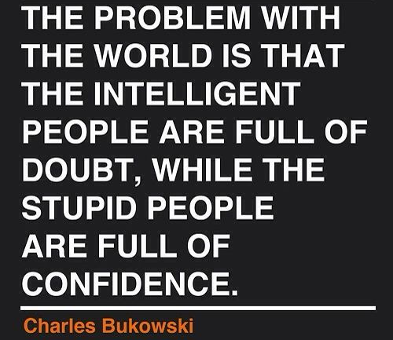
Use me as A Resource!
If you’re struggling with projects, stressing out on exams, not getting the material, or just need some advice about life.
Come meet with me
Schedule a video chat
Let’s talk on the phone
Or grab a coffee
Don’t wait until 8th week when it’s too late!

Slide 6
Course Work
Random Quiz (5-7)%
Midterm (35%)
Final Exam (35%)
Lab (20%)
Lab Exam (3-5%)

Slide 7
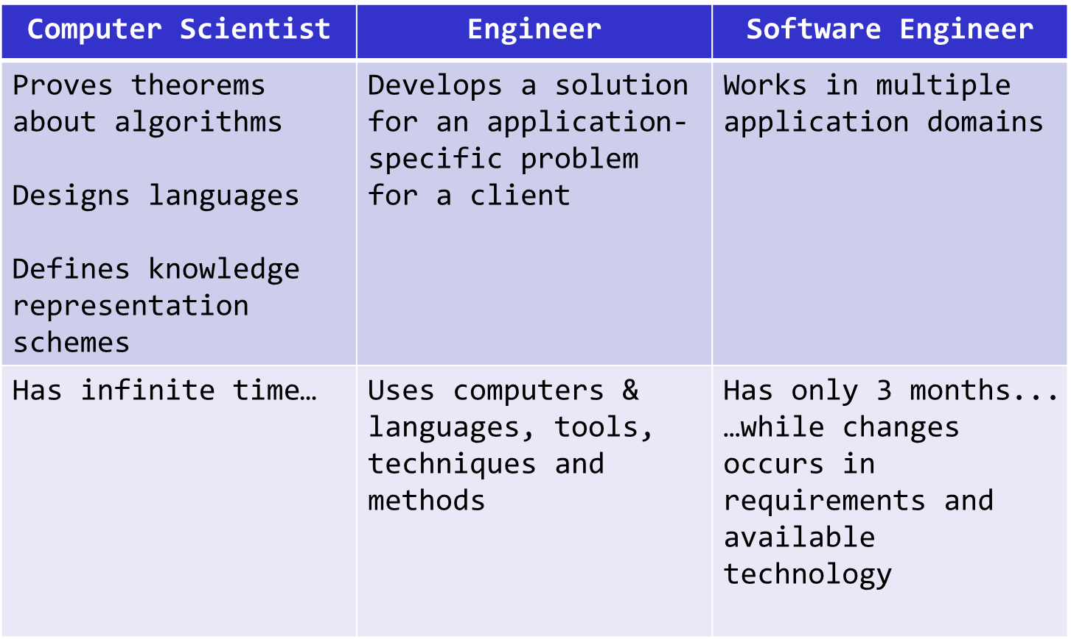
Scientist vs. Engineer

Slide 8
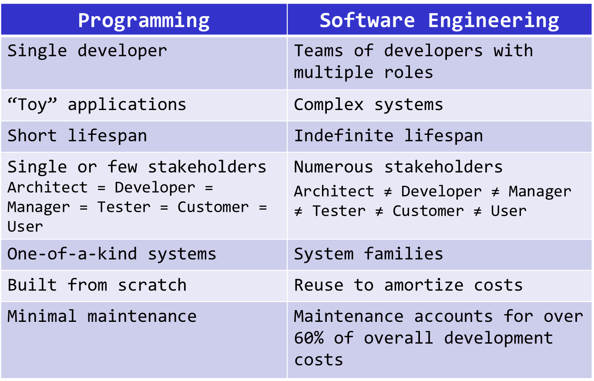
Programming vs. Software Engineering

Slide 9
System Life Cycle
Requirement specification
    What is the purpose of the project
    Descriptions of input and output
Analysis
    To break the problems down into manageable pieces
    Bottom-up approach vs. Top-down approach
System design
    Data objects and operations
    Abstract data type and algorithm specification
Refinement and coding
Verification
    Developing correctness proofs for the program
    Testing the program with a variety of input data

Slide 10
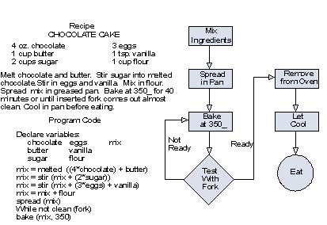
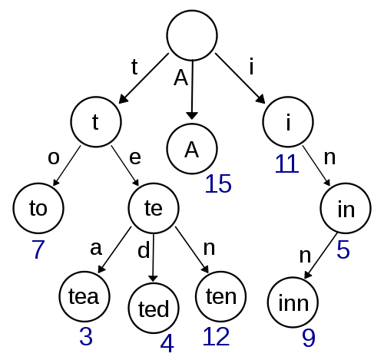
Algo. vs. Data Structure
Algorithms
Data Structures

Slide 11


What is Data Structure
A data structure is the data that’s operated
on by an algorithm to solve a problem.
An algorithm is a set of instructions/steps
that solves a particular problem.
Each algorithm can be classified by
how long it takes to run on a particular input.

Slide 12
Algorithm#1
Let’s try a simple algorithm: We’ll search linearly from top to bottom and ask the user about each word:
j = 0
While I haven’t guessed the user’s word
{
Select word j from the dictionary
Ask the user if word j is the word they picked
j = j + 1
}
Question: If there are N total words in our dictionary, on average, how many guesses will our algorithm require?
Ok, let’s try it.

Slide 13
Algorithm#2
Alright, for our second strategy let’s try a more intelligent approach called binary search:
SearchArea = The entire dictionary
While I haven’t guessed the user’s word
{
Pick the middle word w in the SearchArea
Ask the user: “Is w your word?”
If so, you’re done! Woohoo!
If not, ask: “Does your word come before or after w?”
If their word comes before our middle word w
SearchArea = first ½ of the current SearchArea
If their word comes after our middle word w
SearchArea = second ½ of the current SearchArea
}
Question: If there are N total words in our dictionary, on average, how many guesses will our algorithm require?
Ok, let’s try it.

Slide 14
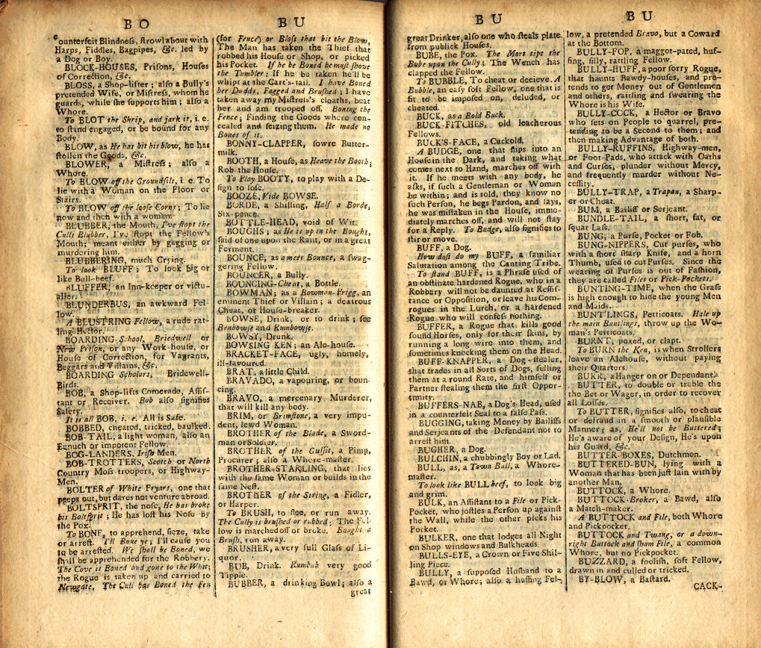
How many Guesses?
We keep on dividing our search area in half until we finally arrive at our word.
In the worst case, we must keep halving our search area until it contains just a single word – our word!
If our dictionary had N=16 words, how many times would we
need to halve it until we have just one word left?
16
8
4
2
1
It would take 4 steps
Ok, what if our dictionary had N=131,072 words?
131072
65536
32768
16384
8192
4096
2048
1024
512
256
128
64
32
16
8
4
2
1
It would take just 17 steps!!! WOW!
Can we come up with a general formula to determine the # of steps?

Slide 15
Significance
Our linear search algorithm requires N/2 steps, on average, to guess the user’s secret word.
(~50,000 steps for a dictionary with 100,000 words)
But our binary search algorithm only requires log₂(N) steps, on average, to guess the user’s secret word.
(~17 steps for a dictionary with 100,000 words)
If, instead of a dictionary, we had to search a database of 300 million people, which algorithm would you choose?

Slide 16

A data Structure :FB
Imagine that you’re building a social
network website like Facebook…
For example, this line indicates that Danny and Jenny are friends.
Friend A Friend B
Danny Hsu Jenny Oh
Danny Hsu Rich Lim
Jenny Oh David Sun
Danny Hsu Carey Nash
Carey Nash Scott Wilhelm
Melani Kan Danny Hsu
Carey Nash David Small
Jenny Oh Len Kleinrock
Jenny Oh Mario Giso
Mario Giso Rich Nguyen
And you want to keep track of
who made friends with whom…
How would you do it?
Well, one data structure
we could use would be a long
list of every pair of friends…
Now how could I find out if
Jenny Oh is a friend of Mario Giso?
Hmmm. But if we had
100 million users with
10 billion friendships, that
might be a bit too slow! ☺
Well, we could search through
every pair until we find the friendship we are looking for…

Slide 17
A Better One
What if instead we assigned each of our N users a number…
Now given a user’s name, how can we quickly find their number?
Right – just use a Binary Search!
Now, to see if two people are friends, all we need to do is…
Look up their numbers A, B
Check (A,B) or (B,A) in our array
If we find a *, they’re buddies!
And kept an alphabetized list of each user → number pair.
Cool – and once we have both users’
numbers, we can use them and a
two-dimensional array
to represent relationships!
User Number
Carey Nash 0
Danny Hsu 1
David Small 2
David Sun 3
Jenny Oh 4
Len Kleinrock 5
Mario Giso 6
Melani Kan 7
Rich Lim 8
Rich Nguyen 9
Scott Wilhelm 10
 | 0 | 1 | 2 | 3 | 4 | 5 | 6 | 7 | 8 | 9 | 10
0
1
2
3
4
5
6
7
8
9
10
*
*
*
FriendA FriendB
Danny Hsu Jenny Oh
David Sun Carey Nash
Jenny Oh David Sun
Danny Hsu Carey Nash
Carey Nash Scott Wilhelm
Melani Kan Danny Hsu
Carey Nash David Small
Jenny Oh Len Kleinrock
Jenny Oh Mario Giso
Mario Giso Rich Nguyen
*
*
*
*
*
*
*
*
*
*
*
*
*
*

Slide 18
A Better One
So what we’ve done is created a new data structure that
makes it faster to determine if two people are friends!
Coupled with our new, more efficient algorithm, we can
quickly find out if two people are friends!
User Number
Carey Nash 0
Danny Hsu 1
David Small 2
David Sun 3
Jenny Oh 4
Len Kleinrock 5
Mario Giso 6
Melani Kan 7
Rich Lim 8
Rich Nguyen 9
Scott Wilhelm 10
0
1
2
3
4
5
6
7
8
9
10
0
*
*
*
1
*
2
*
3
*
*
*
*
4
*
*
*
*
5
*
Friend-finding Algorithm:
Look up their numbers A, B
Check (A,B) or (B,A) in our array
If we find a *, they’re buddies!
6
*
7
*
8
*
*
9
*
10
*

Slide 19
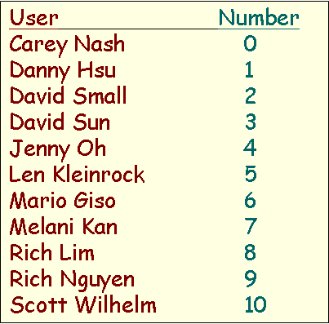
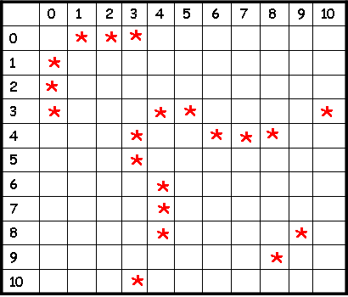
ADT(Abstract Data Type)
An Abstract Data Type or ADT is:
“A coordinated group of
(a) data structures, (b) algorithms and (c) interface functions
that is used to solve a particular problem.”
I’m a set of algorithms.
No one outside of my ADT needs to know how I work.
I’m an interface.
If someone wants to use this ADT, they must call these three functions to work with it.
I’m a set of data structures.
No one outside of my ADT needs to know what I look like!
Abstract Data Type (for finding friends)
Add Friend Algorithm:
1. Look up each person’s #s
2. Stick a * in grid[n1][n2]
3. Stick a * in grid[n2][n1]
Friend-finding Algorithm
1. Look up each person’s #s
2. Check grid[n1][n2] and grid[n2][n1]
3. If we find a *, they’re buddies!
+
+
bool AreTheyFriends(UserA,UserB)
void BecomeFriends(UserA,UserB)
void BreakUp(UserA,UserB)
…
In an ADT, the data structures and algorithms are secret.
The ADT provides an interface (a simple set of functions)
to enable the rest of the program to use the ADT.
Typically, we build programs from a collection of ADTs, each of which solves a different sub-problem.

Slide 20

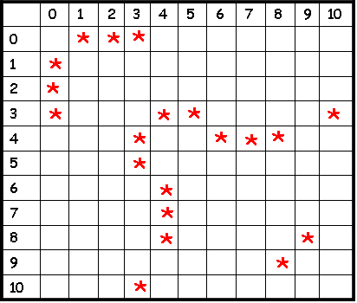
ADTs in C++
User Number
Carey Nash 0
Scott Wilhelm 1
David Smallberg 2
Danny Hsu 3
Jenny Oh 4
Rich Lim 5
David Sun 6
…
We can use C++ classes to define ADTs in our C++ programs!
Each C++ class can hold algorithms, data and interface funcs.
Friend-finding Algorithm:
1. Look up their numbers A, B
2. Check (A,B) or (B,A) in our array
3. If we find a *, they’re buddies!
// define a C++ class for friends
// (this is really an ADT!)
class FriendFinder
{
public:
private:
};
int main()
{
FriendFinder x;
x.BecomeFriends(“Carey Nash”,
”Scott Wilhelm”);
x.BecomeFriends(“Jenny Oh”,
”David Sun”);
…
string userA, userB;
cin >> userA >> userB;
if (x.AreTheyFriends(userA,
userB) == true)
cout << userA << “ is friends with “
<< userB;
}
Once we’ve defined our class,
the rest of our program can use
it trivially.
All our program needs to do is
call the functions in our class’s
public interface!
And yet all of its underlying data
structures and algorithms are hidden!
The rest of the program can ignore
the details of how our class works
and just use its features!
This is the power of the ADT/class!
// our interface functions go here
void BecomeFriends(…);
void AreTheyFriends(…);
...
// secret algorithms go here
…
// secret data structures go here
…

Slide 21
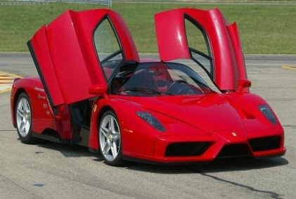

User Number
Carey Nash 0
Scott Wilhelm 1
David Smallberg 2
Danny Hsu 3
Jenny Oh 4
Rich Lim 5
David Sun 6
…
We use a similar approach to construct real-life objects!
Friend-finding Algorithm:
1. Look up their numbers A, B
2. Check (A,B) or (B,A) in our array
3. If we find a *, they’re buddies!
int main()
{
FriendFinder x;
x.BecomeFriends(“Carey Nash”,
”Scott Wilhelm”);
x.BecomeFriends(“Jenny Oh”,
”David Sun”);
…
string userA, userB;
cin >> userA >> userB;
if (x.AreTheyFriends(userA,
userB) == true)
cout << userA << “ is friends with “
<< userB;
}
Consider your car…
It has an easy-to-use interface like the steering wheel, brake and accelerator pedals.
The complicated machinery is hidden from you – you don’t need to know how it works to use it!

Slide 22
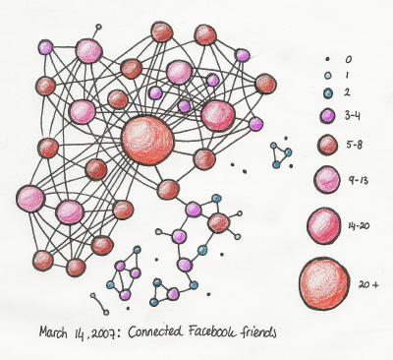
User Number
Carey Nash 0
Scott Wilhelm 1
David Smallberg 2
Danny Hsu 3
Jenny Oh 4
Rich Lim 5
David Sun 6
…
User Number
Carey Nash 0
Scott Wilhelm 1
David Smallberg 2
Danny Hsu 3
Jenny Oh 4
Rich Lim 5
David Sun 6
…
Now what if I wanted to improve my FriendFinder data structures?
Friend-finding Algorithm:
1. Identify the node in the graph for user
2. Perform a breadth-first search from this node
3. Do not follow more than 2 edges…
Friend-finding Algorithm:
1. Look up their numbers A, B
2. Check (A,B) or (B,A) in our array
3. If we find a *, they’re buddies!
int main()
{
FriendFinder x;
x.BecomeFriends(“Carey Nash”,
”Scott Wilhelm”);
x.BecomeFriends(“Jenny Oh”,
”David Sun”);
…
string userA, userB;
cin >> userA >> userB;
if (x.AreTheyFriends(userA,
userB) == true)
cout << userA << “ is friends with “
<< userB;
}
Let’s say I made a radical change to our friend network data structures…
Would the user of my class need to change any part of her program?
No! Because the rest of the program doesn’t rely on these details - it knows nothing about them!
The same is true for your car! If you replace your engine, you don’t care – you just use the steering wheel, accelerator and brakes like you did before!

Slide 23
Characteristics
Characteristic | Description
Linear | The data items are arranged in a linear sequence. Ex: Array
Non-Linear | In Non-Linear data structures, the data items are not in sequence. Ex: Tree, Graph
Homogeneous | All elements are of same type. Ex: Array
Non-Homogeneous | Elements may or may not be the same type. Ex: Structure
Static | At compile time, the size and structure associated memory location are fixed. Ex: Array
Dynamic | Which expands and shrinks depending upon the program need and its execution. Ex: Linked list created using pointer

Slide 24
Types of Data Structure
Data Structure
Build in Data
Integer
Float
User defined data
Arrays
Character
Pointer
Lists
Files
Linear List
Non-Linear List
Stacks
Queues
Trees
Graphs

Slide 25
Performance Analysis
Criteria to judge a program
  Does the program meet the original specifications of the task
  Does it work correctly
  Does the program contain documentation that shows how to use it and how it works
  Does the program effectively use functions to create logical units
  Is the program’s code readable
  Does the program efficiently use primary and secondary storage
  Is the program’s running time acceptable for the task

Slide 26
Performance Analysis
Performance analysis
  Space complexity: a function describing the amount of memory (space) an algorithm takes in terms of the amount of input to the algorithm
  Time complexity: a function describing the amount of time an algorithm takes in terms of the amount of input to the algorithm
  Best case, average case, and worst case analysis
Running time
Worst case
40ms
Average case
30ms
20ms
Best case
10ms
1
2
3
4
5
6
7
Input instance
26

Slide 27
Space Complexity
It’s the amount of memory space required by the algorithm, during the course of its execution. Space complexity must be taken seriously for multi-user systems and in situations where limited memory is available.
Fixed Space Requirement
  instruction space, space for simple variables, fixed sized structured variables, and constants
Variable Space Requirement
  Structured variables whose size depends on the particular instance of the problem
  Recursive algorithm

Slide 28
Example: Space Complexity
Fixed Space
Variable/ Linear Space:
int square (int a)
{
return a*a;
}
2 bytes = interger
4 bytes = floating point
1 byte = charater value
6 or 8 byte = double value
int sun (int A[ ], int n)
{
int sum = 0, i;
for(i=0; i<n; i++)
sum = sum + A[i];
return sum;
}
2*n + 2
2 + 2
2
2*n + 8

Slide 29
Time Complexity
The time complexity of an algorithm is the total amount of time required by an algorithm to complete its execution.
int square (int a, int b)
{
return a+b;
}
Constant Time Complexity
int sumofList (int A[ ], int n)
{
int sum = 0, i;
for (i=0; i<n; i++)
sum = sum + A[i];
return sum;
}
Cost | Repetition | Total
1 | 1 | 1
1 | n+1 | n+1
2 | n | 2n
1 | 1 | 1

Slide 30
Time Complexity: Examples
Statement
s/c
Freq.
Total steps
float sum(float list[], int n)
0
0
0
{
0
0
0
float tempsum=0;
1
1
1
int i;
0
0
0
for (i=0;i<n;i++)
1
n+1
n+1
tempsum+= list[i];
1
n
n
return tempsum;
1
1
1
}
0
0
0
Total
2n+3

Slide 31
Time Complexity: Examples
Example 1
Example 2
  void Ex1(int n) {
    int a, i;
    for (i=0;i<n;i++)
    a=i;
    }
n+1
→ 2n+1
≈ n
n
  void Ex2(int n) {
    int a, i;
    for (i=0;i<n;i+=2)
    a=i;
    }
n/2+1
→ n+1
≈ n
n/2

Slide 32
Time Complexity: Examples
Example 3
Example 4
  void Ex3(int n) {
    int a, i;
    for (i=0;i<n*n;i++)
    a=i;
    }
n²+1
→ 2n² +1
≈ n²
n²
  void Ex4(int n) {
    int a, i, j;
    for (i=0;i<n;i++)
    for (j=0;j<i;j++)
    a=i;
    }
n+1
1+2+…+ n = n(n+1)/2
0+1+…+ (n-1) = n(n-1)/2
→ n² + 2n + 2/2
≈ n²

Slide 33
Time Complexity
Asymptotic Notation
  To determine the practicality of algorithm
  To compare the time complexities of two programs that performs the same function.
  To predict run time on large instance

Slide 34
Asymptotic Notation
Big O(oh):
  Is the set of functions that grow slower than or at the same rate as expression. It indicates the maximum required by an algorithm for all input values. It represents the worst case of an algorithm's time complexity.
Big Ω(Omega):
  is the set of functions that grow faster than or at the same rate as expression. It indicates the minimum time required by an algorithm for all input values. It represents the best case of an algorithm's time complexity.
Big Θ(Theta):
  Consist of all the functions that lie in both O(expression) and Omega(expression). It indicates the average bound of an algorithm. It represents the average case of an algorithm's time complexity.

Slide 35
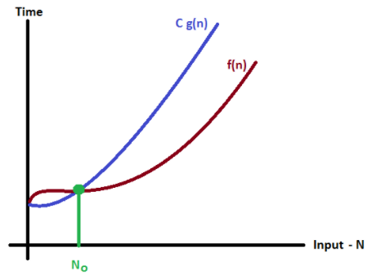
Big Oh
Time Complexity
f(n) = O(g(n)) iff ∃c,n₀ > 0, s.t. f(n) ≤ c⋅g(n) ∀n, n ≥ n₀
3n + 2 = O(n)
3n + 3 = O(n)
10n² + 4n + 2 = O(n²),
6 ⋅ 2^{n} + n² = O(2^{n})
  10n² + 4n + 2 ≠ O(n)

Slide 36
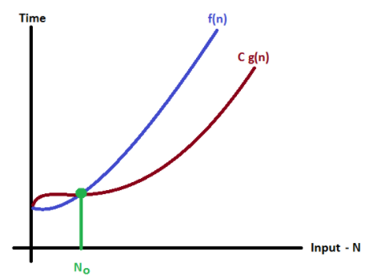
Big Omega
Time Complexity
f(n) =Ω(g(n)) iff ∃c,n₀ > 0, s.t. f(n) ≥ c⋅g(n) ∀n, n≥n₀
3n + 2 = Ω(n)
3n + 3 = Ω(n)
100n + 6 = Ω(n)
10n²+4n+2 = Ω(n²)
6⋅2^{n} + n² = Ω(2^{n})

Slide 37
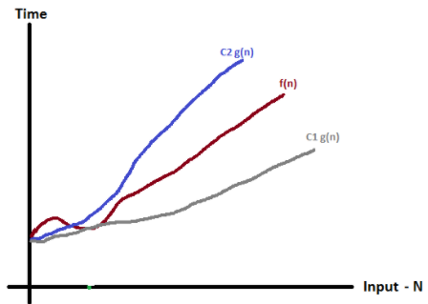
Big Theta
Time Complexity
f(n)=Θ(g(n)) iff ∃c₁, c₂, n₀ > 0, s.t. 0 ≤ c₁⋅g(n) ≤ f(n) ≤ c₂⋅g(n) ∀n, n ≥ n₀
3n + 2 = Θ(n)
  10n² + 4n + 2 = Θ(n²)
  6⋅2^{n} + n² = Θ(2^{n})
  10⋅log n + 4 = Θ(log n)
  2⋅n⋅m + 2⋅n + 1 = Θ(n⋅m)

Slide 38
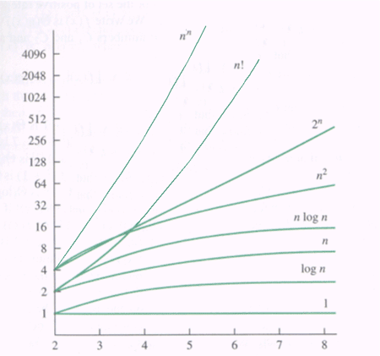
Time Complexity
Time complexity

Slide 39
Recursive Algorithm
Recursion
Suppose
Instead of solving the hard problem
Turn it into a slightly easier version of the same problem
5! = 5*4*3*2*1
Factorial(4)
4! = 4*3*2*1
4*6=24
4*Factorial(3)
3! = 3*2*1
3*2=6
3*Factorial(2)
n! = n*(n-1)!
2*Factorial(1)
2*1

Slide 40
Recursive Algorithm
Algorithm (recursive):
Pros and Cons
  Pros: More natural to express the functions
  Cons: More memory is required than the iterative counterpart
if k = 0, then return 1;
else return 2*Power_of_2(k - 1)
Base case

Slide 41
Thank You
Q & A
6th September, 2019

